Slide 1


Machine learning method workshop
Decision tree, Random forest
Shuqi Lin, PhD
Postdoctoral Fellow
Erken Laboratory and Limnology Department
Uppsala University
Uppsala, Sweden

Slide 2
Unsupervised Learning → Supervised Learning
Unsupervised Learning: a type of algorithm that learns patterns from untagged data.
  E.g. PCA, KNN, etc.
Supervised Learning: the machine learning task of learning a function that maps an input to an output based on example input-output pairs.
  E.g. Decision tree, Random Forest, ANN, etc.

Slide 3
Basic decision tree model
Series of conditional steps in order to make final decision
Water temp >15 °C ?
Water temp >15 °C ?
NO
YES
NO
YES
Sufficient light?
No algal bloom
Algal bloom
No algal bloom
No algal bloom
Sufficient nutrient (N, P)?
No algal bloom
Algal bloom
The deeper the tree, the more complex the decision rules and the fitter the model is
Notes:
The fundamental elements within random forest: basic tree

Slide 4
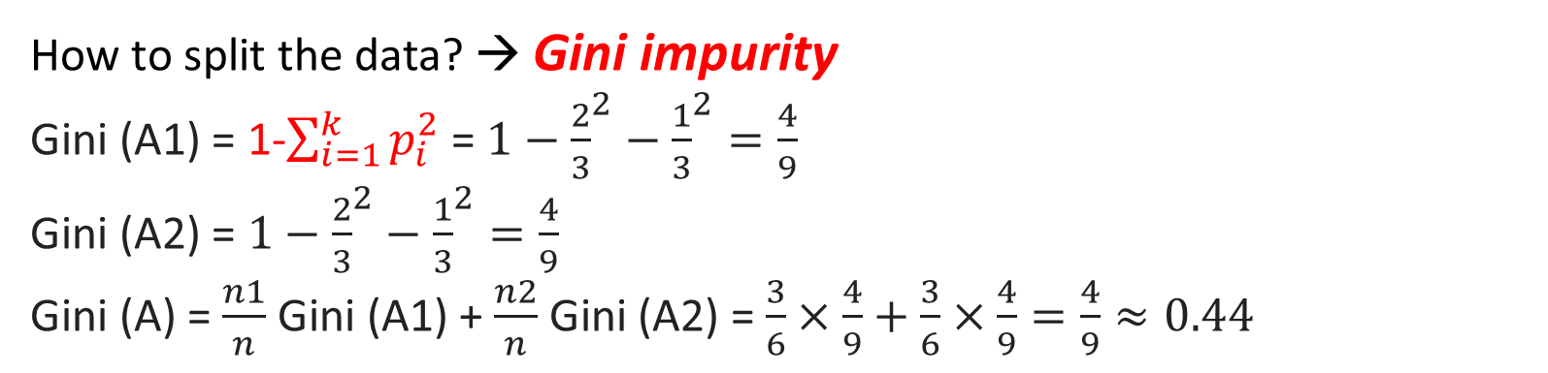


Classification trees
It is OK to mix data types in the same tree
Structure: The Roots, internal nodes (branches), leaves nodes (leaves)
A
Water temp >15 °C ?
Water temp (°C ) | Algal bloom
12 | NO
16 | NO
20 | YES
10 | NO
15 | YES
22 | YES
$$P1=\frac{2}{3}$$
YES
NO
Algal bloom (2), No bloom (1)
Algal bloom (1), No bloom (2)
A1
A2
$$P2=\frac{1}{3}$$
How to split the data? → Gini impurity
Gini (A1) = 1-$\sum_{i=1}^{k}{p_{i}^{2}}$ = $1−{\frac{2}{3}}^{2}−{\frac{1}{3}}^{2}=\frac{4}{9}$
Gini (A2) = $1−{\frac{2}{3}}^{2}−{\frac{1}{3}}^{2}=\frac{4}{9}$
Gini (A) = $\frac{n1}{n}$ Gini (A1) + $\frac{n2}{n}$ Gini (A2) = $\frac{3}{6}×\frac{4}{9}+\frac{3}{6}×\frac{4}{9}=\frac{4}{9}≈0.44$
Notes:
A classification tree is a structural mapping of binary decisions that lead to a decision about the class (interpretation) of an object

Slide 5
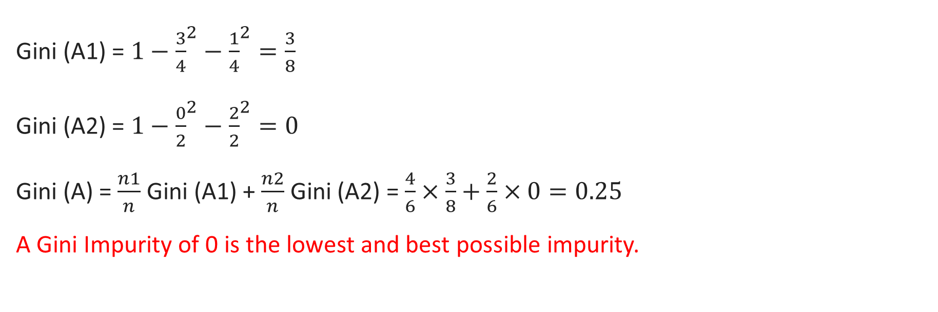
Water temp (°C ) | Algal bloom
12 | NO
16 | NO
20 | YES
10 | NO
15 | YES
22 | YES
Water temp >=12 °C ?
YES
NO
Algal bloom (3), No bloom (1)
Algal bloom (0), No bloom (2)
Gini (A1) = $1−{\frac{3}{4}}^{2}−{\frac{1}{4}}^{2}=\frac{3}{8}$
Gini (A2) = $1−{\frac{0}{2}}^{2}−{\frac{2}{2}}^{2}=0$
Gini (A) = $\frac{n1}{n}$ Gini (A1) + $\frac{n2}{n}$ Gini (A2) = $\frac{4}{6}×\frac{3}{8}+\frac{2}{6}×0=0.25$
A Gini Impurity of 0 is the lowest and best possible impurity.

Slide 6
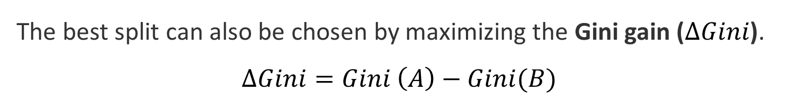
A
Water temp >15 °C ?
YES
NO
B
No algal bloom
Sufficient light?
YES
NO
C
No algal bloom
Sufficient nutrient (N, P)?
Algal bloom
No algal bloom
The best split can also be chosen by maximizing the Gini gain ($∆Gini$).
$$∆Gini=Gini \left(A\right)−Gini(B)$$

Slide 7
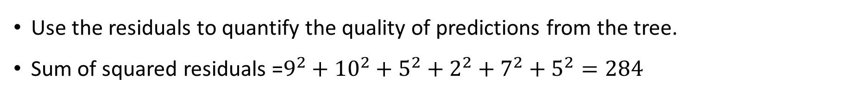
Regression Trees
In a regression tree, each leaf represents a numeric value
Water temp <=15 °C ?
Water temp (°C ) | Chl (μg/L)
12 | 4
16 | 10
20 | 25
10 | 15
15 | 20
22 | 25
YES
NO
Chl = 13 μg/L
Chl = 20 μg/L
Use the residuals to quantify the quality of predictions from the tree.
Sum of squared residuals =$9^{2}+{10}^{2}+$ $5^{2}+2^{2}+7^{2}+5^{2}=284$
Notes:
Regression trees are the decision trees which have continuous values as target variable.

Slide 8
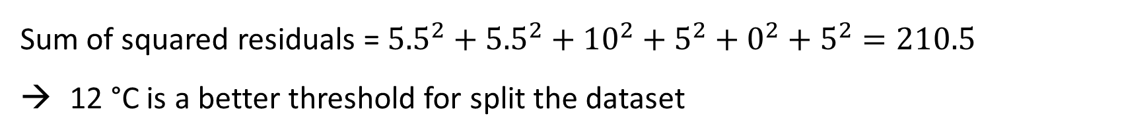
Sum of squared residuals = ${5.5}^{2}+{5.5}^{2}+$ ${10}^{2}+5^{2}+0^{2}+5^{2}=210.5$
12 °C is a better threshold for split the dataset
Water temp (°C ) | Chl (μg/L)
12 | 4
16 | 10
20 | 25
10 | 15
15 | 20
22 | 25
Water temp <=12 °C ?
YES
NO
Chl = 9.5 μg/L
Chl = 20 μg/L
Repeat until we have calculated the sum of squared residuals for all of the remaining thresholds. Find the threshold with the smallest sum of squared residuals.

Slide 9
Water temp (°C ) | Chl (μg/L)
12 | 4
16 | 10
20 | 25
10 | 15
15 | 20
22 | 25
Water temp <=12 °C ?
YES
NO
Chl = 9.5 μg/L
Water temp > 15°C ?
Chl = 20 μg/L
Chl = 4 μg/L
Perfect tree estimator for one dataset is not always a good thing. The model has no bias, but potentially large variance. → Overfitting
Set the minimum number of observations in a leaf or limit the depth of the tree to avoid overfitting.

Slide 10
Tips on practical use of Decision trees
Decision trees tend to overfit on data with a large number of features. Consider dimensionality reduction (e.g. PCA) beforehand to preprocess the dataset.
If you are working on classification problem, balance your dataset before training to prevent the tree from being biased toward the classes that are dominant.
Notes:
Decision trees work great with the data used to create them, but they are not flexible when it comes to classify new samples.

Slide 11
Random Forest
Random forests are based on an ensemble of decision trees, and each tree in the forest depends on the values of a randomly sampled, identically distributed, and independent vector.
Create multiple models (trees), trained over the same data, averaging the results of each model (tree) ultimately finding a more accurate result.
Random forest combine the simplicity of decision trees with flexibility
Notes:
There comes the well-known random forest model. RF combine the simplicity of decision tress with flexibility resulting a vast improvement in accuracy.

Slide 12
Random Forest
Step 1: Bootstrapped dataset
  Create a bootstrapped dataset that is the same size as the original (randomly select samples from the original dataset. Picking the same sample more than once is allowed.)

Slide 13
Water temp (°C ) | Short wave radiation (W) | Wind speed (m/s) | PO4 (μg/L) | Algal bloom
15 | 150 | 3 | 0.1 | NO
12 | 300 | 3 | 0.2 | NO
20 | 250 | 6 | 0.15 | YES
24 | 300 | 5 | 0.1 | YES
Bootstrapped dataset
Water temp (°C ) | Short wave radiation (W) | Wind speed (m/s) | PO4 (μg/L) | Algal bloom
15 | 150 | 3 | 0.1 | NO
12 | 300 | 3 | 0.2 | NO
20 | 250 | 6 | 0.15 | YES
20 | 250 | 6 | 0.15 | YES
Picking the same sample more than once

Slide 14
Random Forest
Step 2: Create a decision tree based on the bootstrapped dataset
  Only use a random subset of features at each step

Slide 15
Water temp <=12 °C ?
PO4 < 0.12 μg/L
Only considering a random subset of features to split the data at each step
Algal bloom
Wind spd >5?
SWR >200
Algal bloom
No bloom
Repeat these two steps. Ideally, you’d do this hundreds of times
→ A wide variety of trees → the variety makes RF more effective than individual decision tress

Slide 16
How to prune the forest we created?
Take the samples that do not in the bootstrapped dataset (Out-Of-Bag dataset) , and run them through the forest. See what are the results predicted by the majority of trees.
  these samples should be about 1/3 of the original data
Ultimately, we can measure how accurate our RF is by the proportion of Out-Of-Bag samples that were correctly classified → Out-Of-Bag Error.
Use the Out-Of-Bag Error to improve the RF by changing the number of features used per step.
Repeat the processes and then choose the one that is most accurate.

Slide 17
Additional use of Random Forest
Except for working as a predictive model, RF can produce two additional pieces of information:
  A measure of the importance of the predictor variables;
  A measure of the internal structure of the data (the proximity among the data points)

Slide 18
Reference
https://scikit-learn.org/stable/modules/tree.html
https://scikit-learn.org/stable/modules/classes.html#module-sklearn.ensemble
https://www.youtube.com/c/joshstarmer StatQuest (highly recommended for beginner)

Slide 19
Examples…

Slide 20
Gradient Boost Regressor (Gradient Boosting Machine)
One of the variants of ensemble methods where you create multiple weak models and combine them to get better performance as a whole.
The decision trees in gradient boosting are built additively; in other words, each decision tree is built one after another.

Slide 21
Difference between RF and GBR
In RF, the results of decision trees are aggregated at the end of the process.
In GBR, the results of each decision tree are aggregated along the way to calculate the final result.
Overall, GBR usually performs better than RF, but they’re prone to overfitting.

